Slide 1
Veterinary Public Health
Health :- is astate of complete physical,mental & social well-being & not merely the absence of disease or infirmity (WHO,1978)

Slide 2
Food Hygiene:- is Divided in to :-
Milk&Meat hygiene+Environmental pollution.
Milk Hygiene:The term milk hygiene covering both:-
a.The bacteriological quality of the milk . b.Herd health aspects that can effect quality & yield of milk.

Slide 3
Milk has a (Biological&Chemical&Legal Definition). Milk is the natural secretion of m.g of mammalia ,it is the only food of the young mammal during the first period of its life .the substances in milk provide both energy &the building material for growth .Milk also contains antibodies which protect young mammal against infection .
Dairy products include :-Cream,Butter,Cheese,Yogurt,Cocentrated milk, Dry milk (Powder),Infant Formulas Versus Breast milk, Ice-cream …etc.

Slide 4
Colostrum:- It is the secretion of mammary gland during the first few days of lactation after birth (parturition) , over aperid of 3-6 days. then acquier normal milk composition ; Colostrum is :- 1-higher in casein,albumin,globulin & ash than milk
2-lower in water, lactose & fat than milk .

Slide 5
-Physical properties of milk:-
1-The color of milk 2-Flavor of milk (Taste & Odor)
3-Spesific gravity of milk (sp.gr.)
4-Freezing point of milk
5-pH &Titratable acidity
6-Boiling point of milk

Slide 6
7-Cream line formation
8-Foam
9-Effect of heat on milk
10-Viscosity of milk
11-Adhesaiveness of milk
12-Effect of acids on milk
13-Chemical reaction of milk :-
Milk is (Amphotric) due to presence of both (COOH) & (NH₃) group

Slide 7
1- Chemical Composition of Raw Milk (2 h.) :-
1-Major constituents of milk are:- Water,milk Fat ,Protein ,Lactose & minerals salts .
2-Minor constituents of milk are:- Vitamines ,Enzymes ,Body cells & Gases in milk .

Slide 8
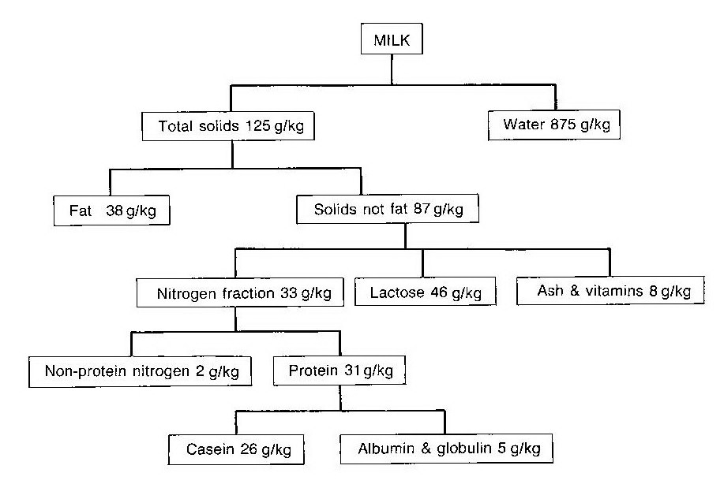

Slide 9
Water:- 87.48%
Water content of milk can range from a low content in marine animal to a high content in human & other animals .

Slide 10
Milk Fat (Butter fat):-
1-True Milk fat :-
it is Triglycerid it means one molecule of glycerol that is combined with three molecules of short chain fatty acids 4 ,6 ,8 ,10 Carbon atomes ( mainly Butyric 4% ) .
Each fat globule is surrounded by very thin film or membrane of protein & phospholipid (lecithin) which assist in maintaining the stability of emulsion in milk & protect the triglyceride from lipase . - The melting point of milk fat different between 32-36 C . -The Specific gravity of milk fat is 0.93 .

Slide 12
- Chemical changes in milk fat :
a-Oxiditive Rancidity (by O₂ exposure) b-Hydrolytic Rancidity (by lipase) c-Ketonic Rancidity (by Fungus)

Slide 13
2- Milk fatty acids :-
There are at least 64 different fatty acids in milk - about 60-70% of total fatty acids are saturated
about 25-30% of total fatty acids are unsaturated
- about 4% of total fatty acids are poly unsaturated
3- Milk Fat Conjugated Materials :-
1-Phospholipids (lecithin) .
2-Cholestrol .
3-Fat soluble vitamins (E,D,A&K).
4-Carotene .

Slide 14
Milk Proteins :-
1-Casein
Casein constituts about 80% of the total milk protein & is the princible protein compound of milk . the percentage of casein of milk is 2.6% .
There are at least three separate casein as:-
a.Alph-casein 75% (α-s1 , α-s2), Kapa-casein(κ )
b.Beta-casein 22% (β)
c.Gama-casein 3% (γ)

Slide 15
Methods of casein precipitation:
by dilute acid ,alcohol ,Rennine enzyme, Centrifugation ,heat ,heavy metals as:- (Mercury,Silver,Lead,Copper,Zinc&Iron)

